Slide 1
STT
Speech-to-Text
Muhammad Bilal | Umair Rasheed |Muhammad Faizan | Hammad Awan

Slide 2
Speech-to-Text (STT) is a technology that converts spoken language into written text using algorithms, artificial intelligence, and natural language processing (NLP). It allows computers, smartphones, and other devices to "listen" to human speech, process it, and display it as text output.

Slide 3
What we did
User ID
User History
Speech-to-text
Text-to-Speech
Sentiment Analysis
Report Generation

Slide 4
“
“
Audio Input
Signal Processing
Speech Recognition
Language Processing
Text Output

Slide 5
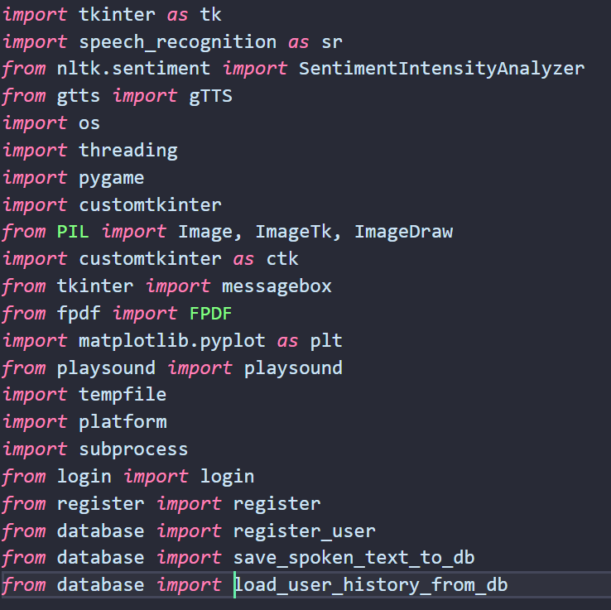
Libraries we used
CustomTkinter (ctk): Used for GUI development.
FPDF: To generate PDF reports.
SpeechRecognition: For handling speech-to-text conversion.
GTTS (Google Text-to-Speech): For converting text into speech.
Playsound: To play the generated audio.

Slide 6
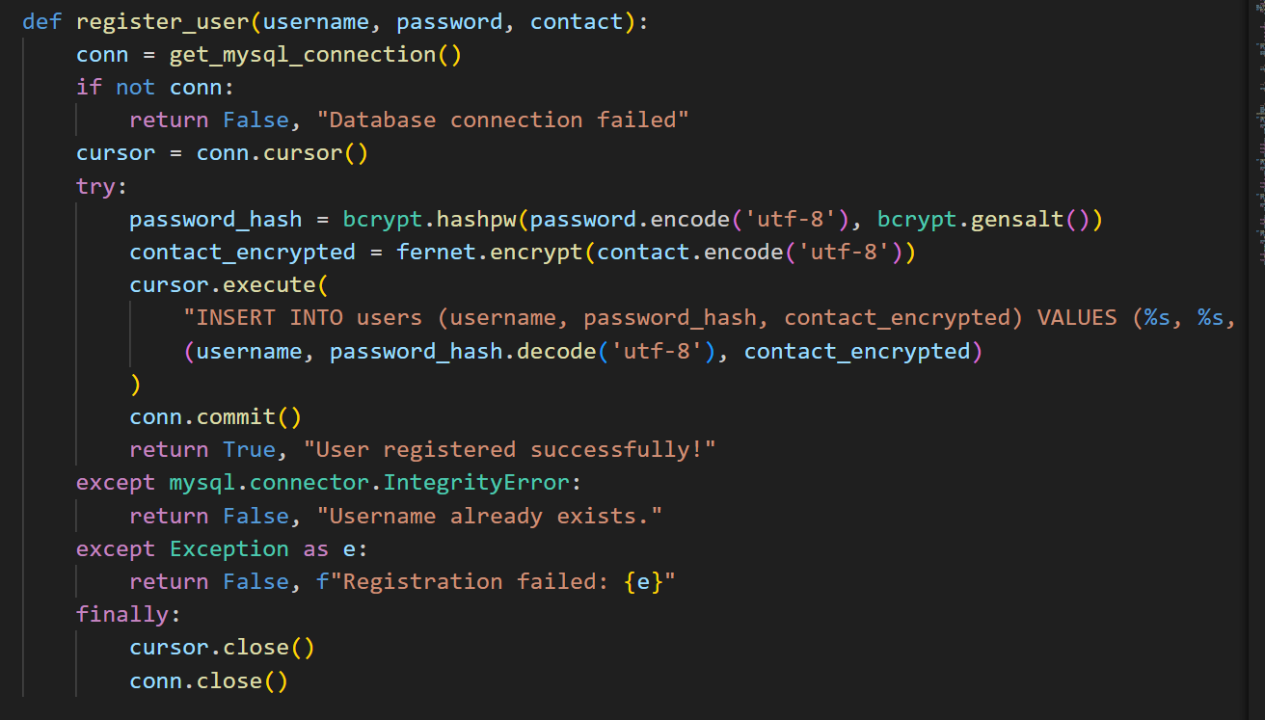
Users
Each User have their account in DB……
Enter your username,
Enter your password,
Enter your confim pass
Enter your Mobile Number
You’re good to Go,…

Slide 7
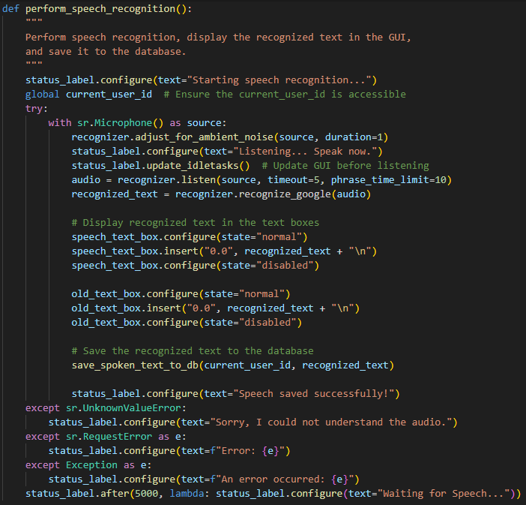
How it work
Listens to the dictated speech
Processes the audio using the recognize_google(audio)
The text is displayed
The dictated speech is converted to text.

Slide 8
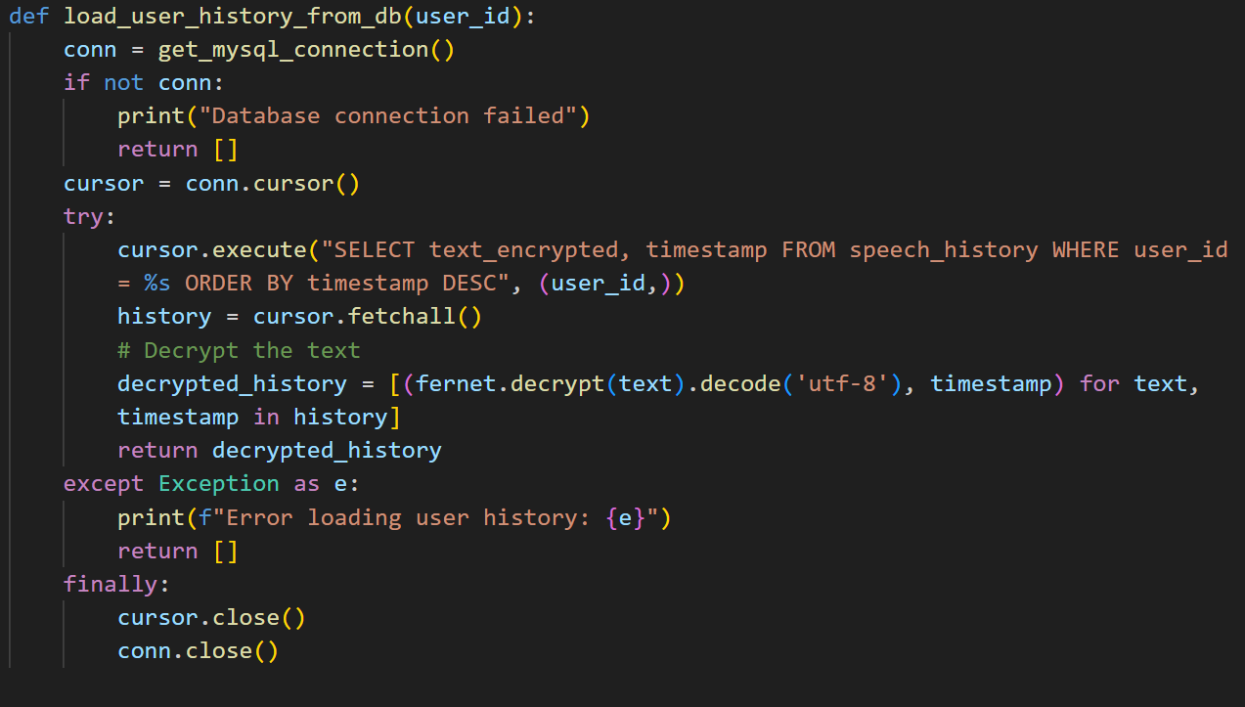
History
Your all previous history is saved, in our DB…,

Slide 9
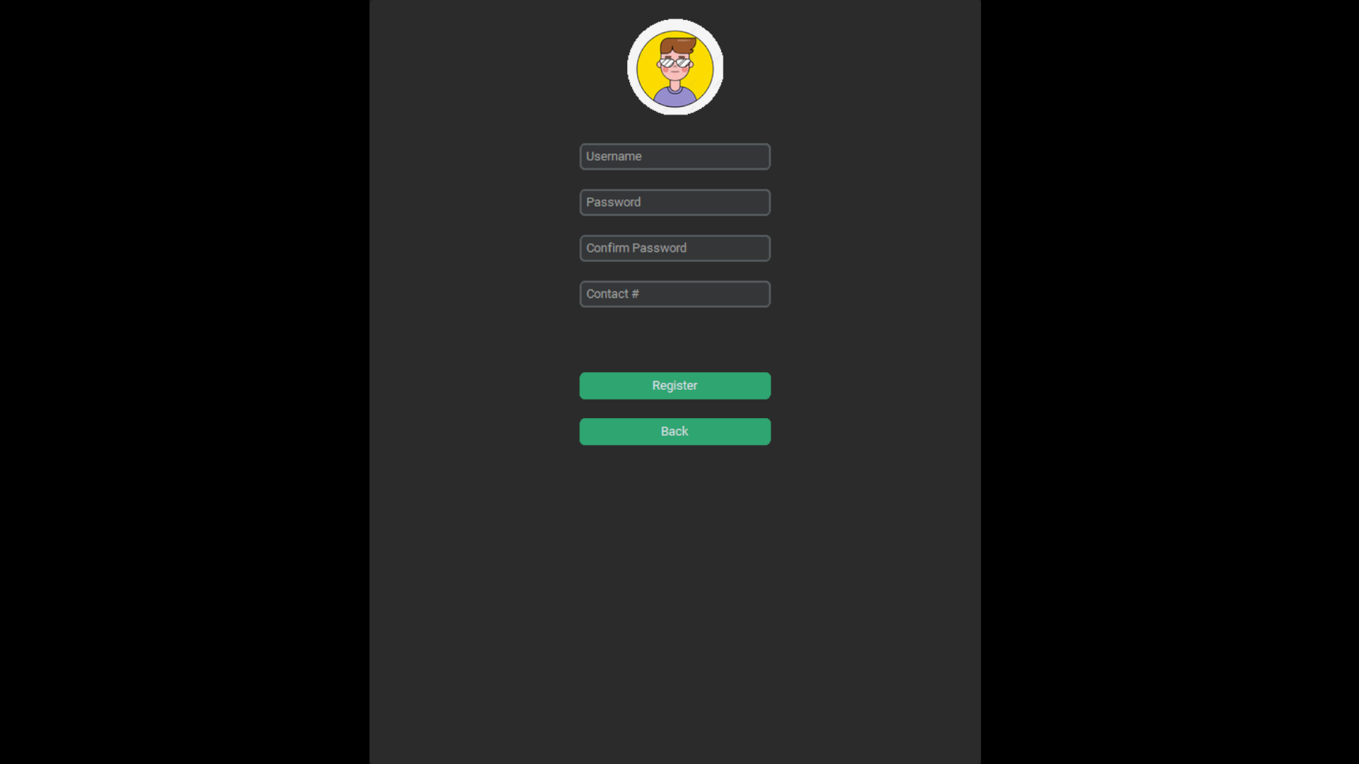

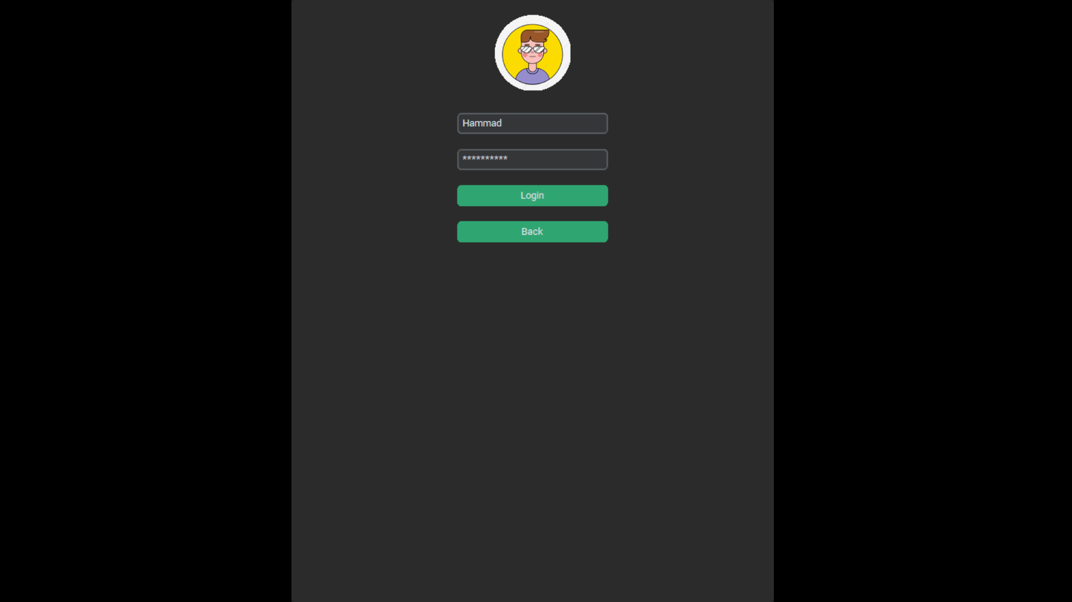

Slide 10
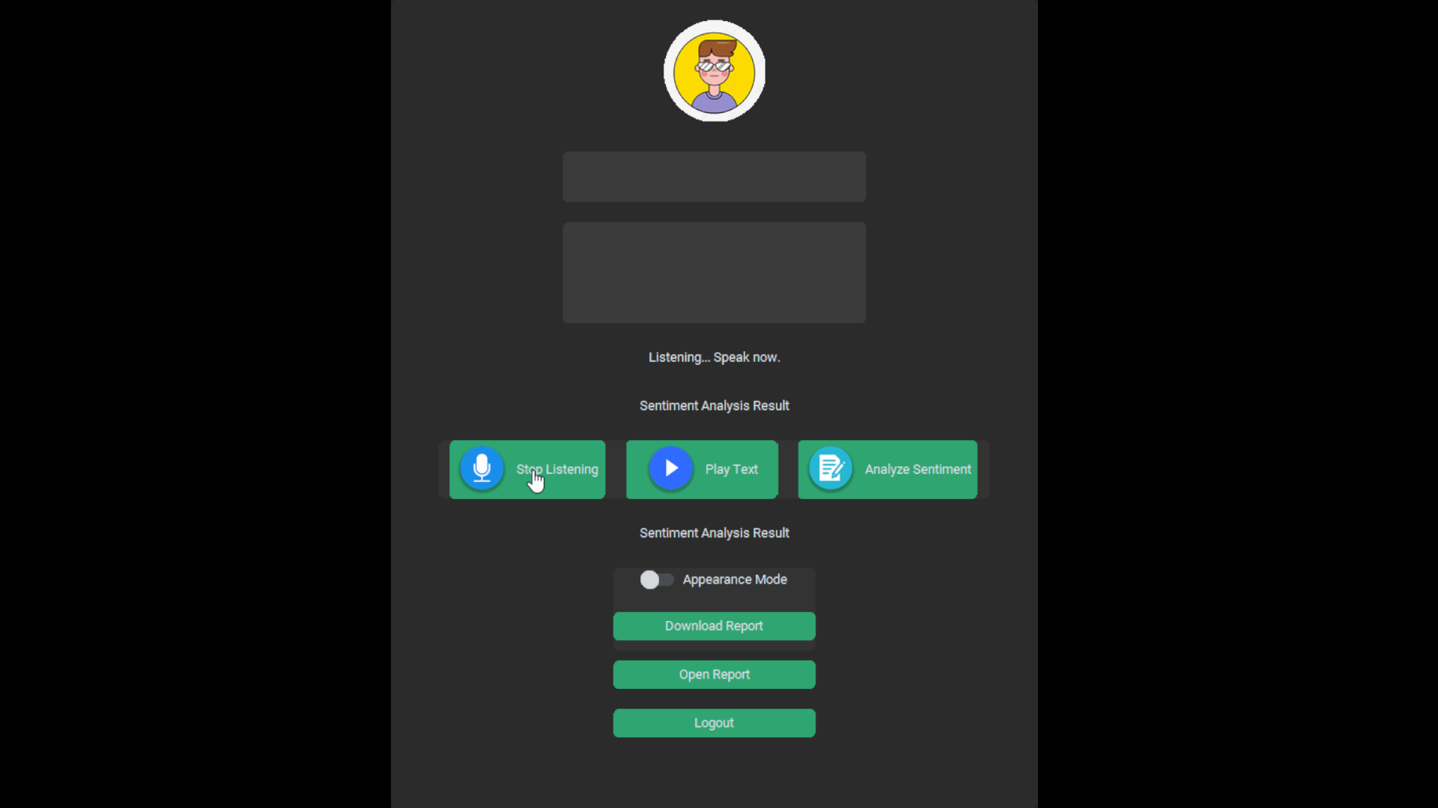
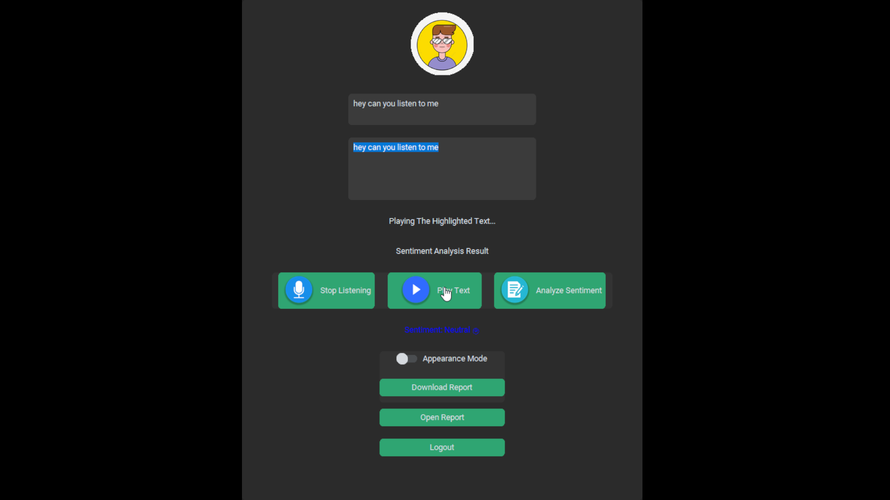


Slide 11

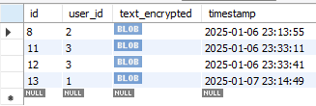
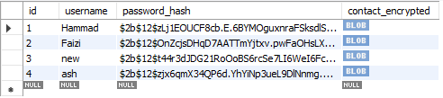
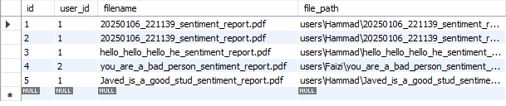
DataBase

Slide 12
Turn On TV….
Turn On Light ….
Turn On AC ….
Alexa

Slide 13
Hi Google, What is NLP

Slide 14


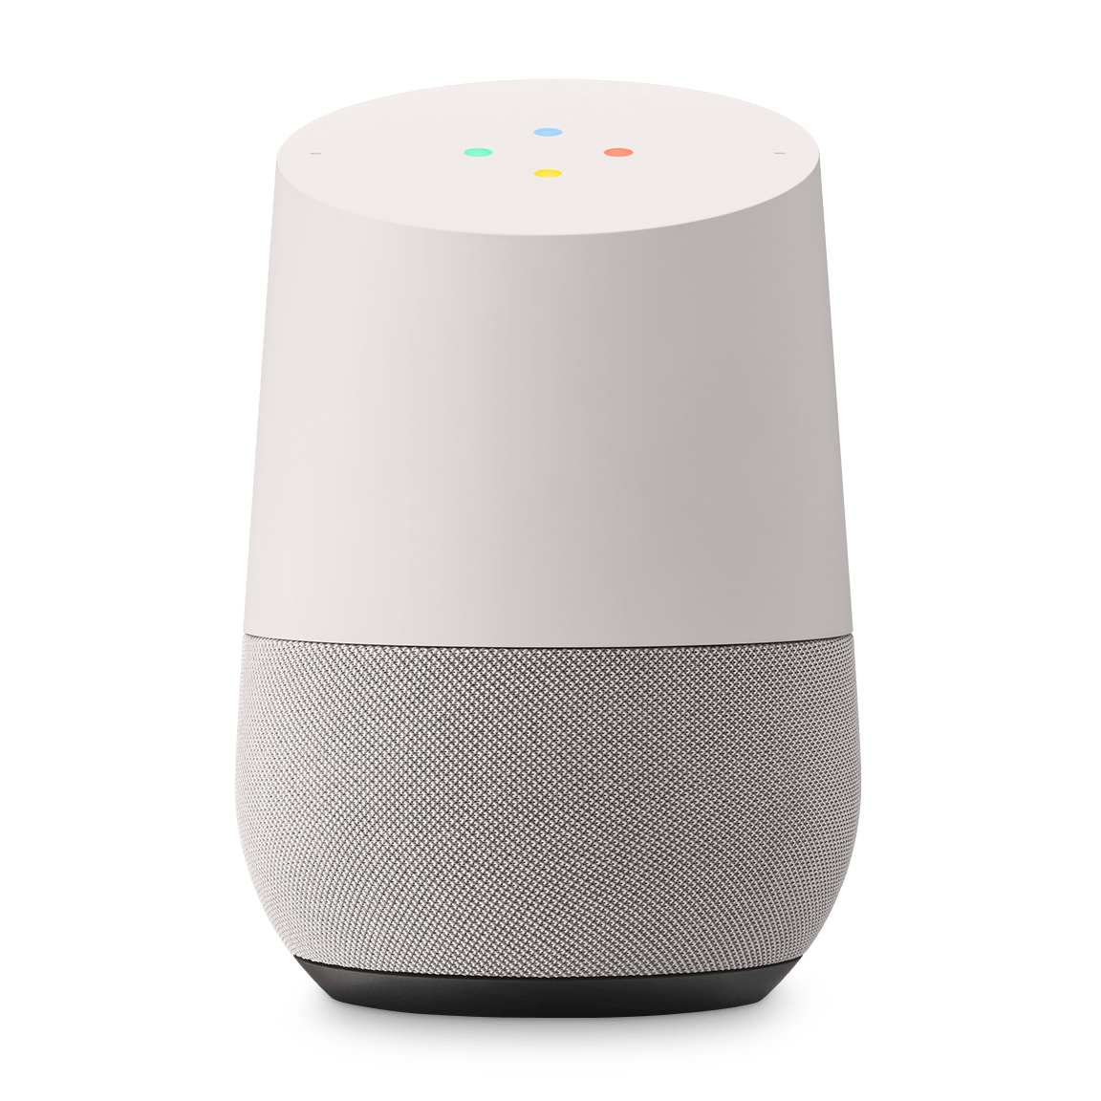
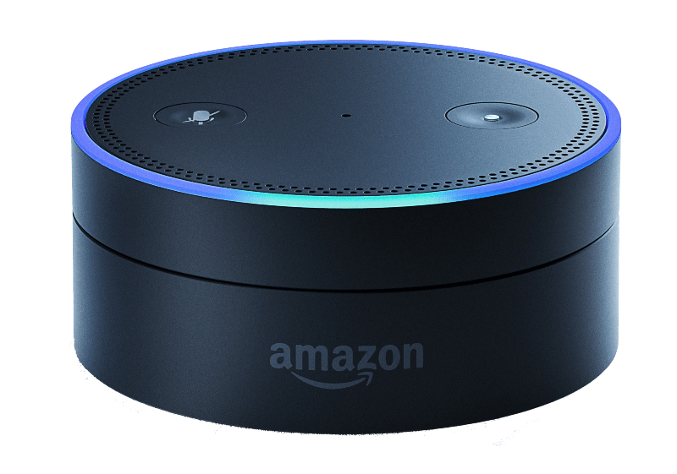

Slide 15
Pros:
Pros:
Increased Productivity
Accessibility
Hands-Free Convenience
Enhanced Usability
Integration with Smart Devices

Slide 16
Pros:
Cons:
Accuracy Issues
Dependence on Internet Connectivity
Learning Curve

Slide 17
Pros:
For Future:
Add the ability to upload audio files for text extraction.Implement sentiment analysis on the extracted text.
Integrate a feature to Convert the speech to text for chatbot understanding and responses.

Slide 18
Pros:
Applications:
Customer Support
Health Care
Media and content creation
market Research

Slide 19
Pros:
Conclusion:
Speech-to-text technology transforms spoken language into written text, enhancing accessibility, productivity, and communication. With ongoing advancements, it continues to simplify tasks and bridge communication gaps, proving to be an essential tool in modern life.

